Slide 1
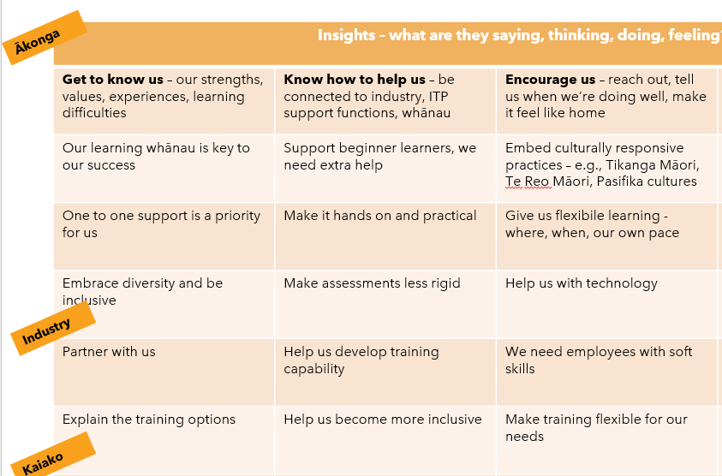
The Te Rito reports and personas
Four key themes were gathered from insights from the Te Rito reports, the personas, our Charter and the Tertiary Education Strategy.

Slide 2
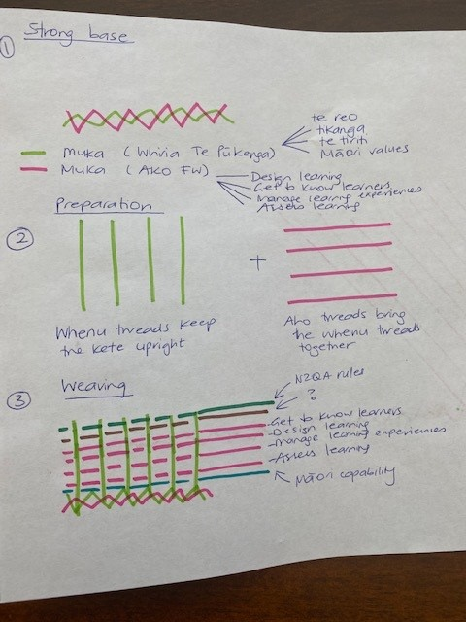
Ako Framework ideas

Slide 3
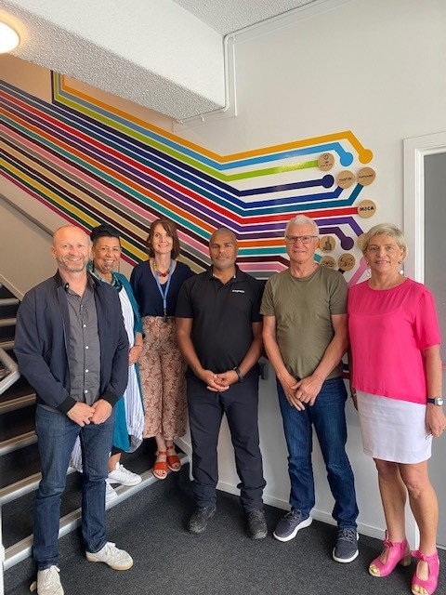
Taura-Here and the Ako Framework prototypes
Using a human centred design approach, we asked Taura-Here (Champions from across the network) to submit Ako Framework prototypes.

Slide 4
Prototype sorting into ‘buckets’
We received over 70 prototypes from our Taura-Here. These prototypes were sorted into common ideas, or ‘buckets’.

Slide 5
Guiding principles
It became clear that the Ako Framework needed to be designed in such a way that represented the six ‘buckets’. Guiding principles (tikanga) from each prototype was placed in a corresponding ‘bucket’. Once in the correct bucket, the guiding principles were then grouped into the four themes below:
Future skills/human skills
Accessible, responsive, flexible
Practical/work based authentic
Relationships/partnerships

Slide 6
Working with capability experts
Using this process, we developed our first iteration of principles (tikanga) for capability development across Te Pūkenga.
After receiving a number of prototypes from Taura-Here from the LTAG (Learning and Teaching Advisory Group), we decided to work with representatives from this group to review and refine the guiding principles from all the prototypes that centred on capability development.
Historically over 60% of our ākonga are work-based, so it was a priority to bring together capability experts from WBL subsidiaries too.
Our focus area

Slide 7
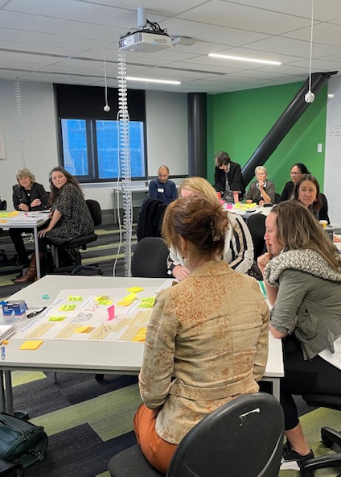
Wānanga
Members of the Ako Framework steering group held a one-day wānanga in Wellington on Thursday July 7, 2022.
The priority was whakawhanaungatanga and understanding how our mahi linked together, and our kaupapa was to:
review and refine the initial draft list of guiding principles (tikanga) for Kaiako capability development across Te Pūkenga
share examples of ako best practices from across the network: on campus, work-based, distance.

Slide 8
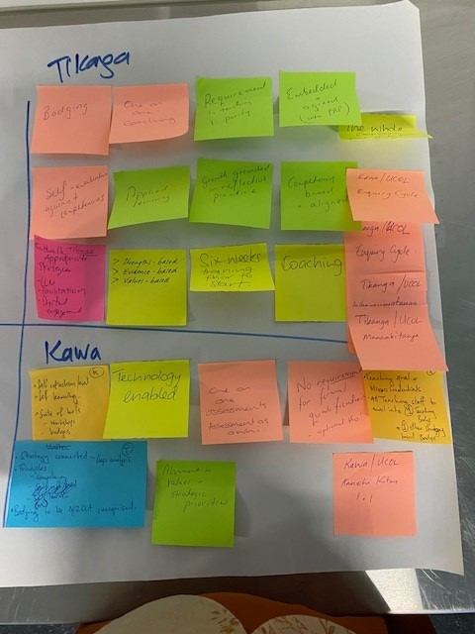
Wānanga insights
We hoped these examples of ako would feed into the development of key capabilities required for what we might see, hear in the future at Te Pūkenga. We believed if we could gather examples of great ako, we could start building a capability framework.
We also provided the opportunity for three capability teams to introduce ‘how’ (kawa) they supported capability development in their context. Insights were gained from Unitec, BCITO and UCOL.

Slide 9
DRAFT Capability Tikanga (guiding procedures)
After our wānanga, we refined the high-level principles (tikanga) to create the second iteration. We then went back to members of the wānanga group for further feedback at an online hui.
The high level principles were further refined at an ADI hui at Manukau Institute of Technology. This was our third iteration.
Further feedback from various groups has led to our fourth iteration of the high level principles (tikanga) for capability development across Te Pūkenga.
This iteration will now go out to the Ako Framework for wider consultation and feedback.
After our wānanga, we refined the high-level principles (tikanga) to create the second iteration. We then went back to members of the wānanga group for further feedback at an online hui.
The high level principles were further refined at an ADI hui at Manukau Institute of Technology. This was our third iteration.

Slide 10
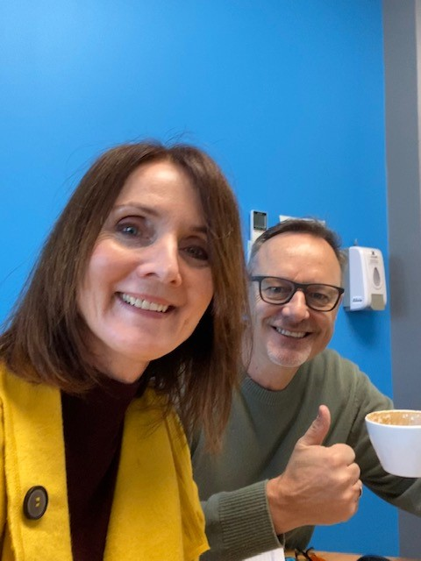
Feedback
Engagement from our capability team of experts has been fantastic! Feedback about the draft tool and tikanga statements has brought people from across the network together, asking questions, supporting each other and imagining what could work and what won’t.
At our wānanga, we learnt that the roles of an on-campus Kaiako, a training advisor at a WBL subsidiary and an on-job trainer were very different! We had a go at developing a tool that might be used across the Te Pūkenga network to support capability development discussions.
At an online hui with a smaller group of capabilty development experts across the network, we shared this tool, reshaped it a bit after feedback and took it back to the ADI team and the wider capability group for further feedback.

Slide 11
DRAFT Tool to support Ako capability discussions
Future skills
In partnership
Hands on
Responsive
Ako |  | Do this occasionally |  | Do this regularly |  | Do this often
Get to know your ākonga |  | Kaiako share and explain Ākonga listen |  | Ākonga share and explain Kaiako watch and listen |  | Ākonga use their strengths, knowledge and experiences Kaiako learn from ākonga
Design and support learning experiences |  | Kaiako present & demonstrate Ākonga listen and watch |  | Ākonga try things Kaiako mentor |  | Ākonga solve problems Kaiako coach
Facilitate learning experiences for your ākonga |  | Ākonga follow instructions Kaiako treat everyone the same |  | Ākonga all learn differently Kaiako help Ākonga learn |  | Ākonga learn together (tuakana-teina) Kaiako provide the activity, job or scenario
Find out if your ākonga have gained new knowledge and skills |  | Ākonga copy Kaiako give feedback |  | Ākonga give feedback to each other Kaiako listen, watch and feedback |  | Ākonga learn from experience and know when they’re successful Kaiako ask questions
Think about what has worked and what you could do differently

